Slide 1
ECE408 / CS483 Applied Parallel Programming Lecture 1: Introduction

Slide 2
Course Goals
Learn how to program massively parallel processors and achieve
high performance
functionality and maintainability
scalability across future generations
Technical subjects
principles and patterns of parallel algorithms
processor architecture features and constraints
programming API, tools and techniques

Slide 3
People
Professors:
Wen-mei Hwu
215 CSL, w-hwu@uiuc.edu, 244-8270
use ECE408 to start your e-mail subject line
Office hours: 11:00am-noon Tuesdays; or by appointment
David Kirk
Fellow, NVIDIA and Professor of ECE
Teaching Assistants:
Izzat El Hajj, Abdul Dakkak, and Nasser Anssari
Office hours: TBA

Slide 4
Web Resources
SharePoint: https://ece408.hwu.crhc.illinois.edu
Handouts and lecture slides/recordings
Textbook chapters, documentation, software resources
Note: While we’ll make an effort to post announcements on the web, we can’t guarantee it, and won’t make any allowances for people who miss things in class.
Web board discussions (in SharePoint)
Channel for electronic announcements
Forum for Q&A - the TAs and Professors read the board, and your classmates often have answers
Compass - grades

Slide 5
Grading
Exam: 30%
Labs (Machine Problems): 30%
Demo/knowledge: 25%
Functionality and Performance: 40%
Report: 35%
Project: 40%
Design Document: 25%
Project Presentation: 25%
Demo/Functionality/Performance/Report: 50%

Slide 6
Academic Honesty
You are allowed and encouraged to discuss assignments with other students in the class. Getting verbal advice/help from people who’ve already taken the course is also fine.
Any reference to assignments from previous terms or web postings is unacceptable
Any copying of non-trivial code is unacceptable
Non-trivial = more than a line or so
Includes reading someone else’s code and then going off to write your own.

Slide 7
Academic Honesty (cont.)
Giving/receiving help on an exam is unacceptable
Penalties for academic dishonesty:
Zero on the assignment for the first occasion
Automatic failure of the course for repeat offenses

Slide 8
Team Projects
Work can be divided up between team members in any way that works for you
However, each team member will demo the final checkpoint of each project individually, and will get a separate demo grade
This will include questions on the entire design
Rationale: if you don’t know enough about the whole design to answer questions on it, you aren’t involved enough in the project

Slide 9
Text/Notes
D. Kirk and W. Hwu, “Programming Massively Parallel Processors – A Hands-on Approach,” Morgan Kaufman Publisher, 2010, ISBN 978-0123814722
We will be using a pre-production version of the 2nd Edition, all chapters are in SharePoint
NVIDIA, NVidia CUDA C Programming Guide, version 4.0, NVidia, 2011 (reference book)
Lecture notes and recordings will be posted at the class SharePoint and web site

Slide 10
ECE498AL – ECE408/CS483
Kirk gives guest lecture at Hwu’s class. Blahut challenges
Kirk and Hwu
NVIDIA announces G80,
Hwu/students training at NVIDIA
NVIDIA releases CUDA, UIUC lecture and lab material went on-line, G80 cards
1/06
…
11/06
1/07
2/07
3/07
6/08
Kirk visits UIUC,
picking UIUC over others
Kirk and Hwu
in panic mode cooking up course material
NAMD and other apps group report results and post projects
UIUC becomes world’s first CUDA Center of Excellence
Notes:
MCM: Any HP Labs people?
MCM: Also, to please our HP and Intel friends, we should use
Itanium and Itanium Architecture instead of IA64...except
maybe when referring to the early development stages of
the architecture.

Slide 11
Tentative Schedule
Week 1:
Thu: Lecture 1: Introduction
MP-0, installation, test account
Week 2:
Tue: Lecture 2: CUDA Intro
Tue: Lecture 3: Data Parallelism Model (make-up class)
Thu: Lecture 4: Data Parallelism Model
MP-1, vector addition
Week 3:
Thu: Lecture 5 – CUDA Memory Model
Tue: Lecture 6 - CUDA Memory Model
MP-2, simple matrix multiplication

Slide 12
Blue Waters Hardware
Cray System & Storage cabinets:
>300
Compute nodes:
>25,000
Usable Storage Bandwidth:
>1 TB/s
System Memory:
>1.5 Petabytes
Memory per core module:
4 GB
Gemin Interconnect Topology:
3D Torus
Usable Storage:
>25 Petabytes
Peak performance:
>11.5 Petaflops
Number of AMD Interlogos processors:
>49,000
Number of AMD x86 core modules:
>380,000
Number of NVIDIA Kepler GPUs:
>3,000

Slide 13
Cray XK7 Compute Node
PCIe Gen2
XK7 Compute Node Characteristics
AMD Series 6200 (Interlagos)
NVIDIA Kepler
Host Memory 32GB 1600 MT/s DDR3
NVIDIA Tesla X2090 Memory 6GB GDDR5 capacity
Gemini High Speed Interconnect
Keplers in final installation
HT3
HT3
Z
Y
X

Slide 14
CPU and GPU have very different design philosophy
GPU
Throughput Oriented Cores
CPU
Latency Oriented Cores
Chip
Chip
Compute Unit
Core
Cache/Local Mem
Local Cache
Registers
SIMD Unit
Threading
Registers
Control
SIMD Unit

Slide 15
CPUs: Latency Oriented Design
Large caches
Convert long latency memory accesses to short latency cache accesses
Sophisticated control
Branch prediction for reduced branch latency
Data forwarding for reduced data latency
Powerful ALU
Reduced operation latency
Control
ALU
ALU
ALU
ALU
CPU
Cache
DRAM

Slide 16
GPUs: Throughput Oriented Design
Small caches
To boost memory throughput
Simple control
No branch prediction
No data forwarding
Energy efficient ALUs
Many, long latency but heavily pipelined for high throughput
Require massive number of threads to tolerate latencies
GPU
DRAM

Slide 17
Winning Applications Use Both CPU and GPU
CPUs for sequential parts where latency matters
CPUs can be 10+X faster than GPUs for sequential code
GPUs for parallel parts where throughput wins
GPUs can be 10+X faster than CPUs for parallel code

Slide 18
Heterogeneous parallel computing is catching on.
Financial Analysis
Scientific Simulation
Engineering Simulation
Data Intensive Analytics
Medical Imaging
Digital Audio Processing
Digital Video Processing
Computer Vision
Biomedical Informatics
Electronic Design Automation
Statistical Modeling
Ray Tracing Rendering
Interactive Physics
Numerical Methods
280 submissions to GPU Computing Gems
110 articles included in two volumes

Slide 19
Parallel Programming Work Flow
Identify compute intensive parts of an application
Adopt scalable algorithms
Optimize data arrangements to maximize locality
Performance Tuning
Pay attention to code portability and maintainability

Slide 20
Software Dominates System Cost
SW lines per chip increases at 2x/10 months
HW gates per chip increases at 2x/18 months
Future system must minimize software redevelopment

Slide 21
Keys to Software Cost Control
App
Scalability
Core A

Slide 22
Keys to Software Cost Control
App
Scalability
The same application runs efficiently on new generations of cores
Core A
Core A 2.0

Slide 23
Keys to Software Cost Control
App
Scalability
The same application runs efficiently on new generations of cores
The same application runs efficiently on more of the same cores
Core A
Core A
Core A

Slide 24
Scalability and Portability
Performance growth with HW generations
Increasing number of compute units
Increasing number of threads
Increasing vector length
Increasing pipeline depth
Increasing DRAM burst size
Increasing number of DRAM channels
Increasing data movement latency
Portability across many different HW types
Multi-core CPUs vs. many-core GPUs
VLIW vs. SIMD vs. threading
Shared memory vs. distributed memory

Slide 25
Keys to Software Cost Control
App
App
App
Scalability
Portability
The same application runs efficiently on different types of cores
Core B
Core A
Core C

Slide 26
Keys to Software Cost Control
App
App
App
Scalability
Portability
The same application runs efficiently on different types of cores
The same application runs efficiently on systems with different organizations and interfaces

Slide 27
Parallelism Scalability

Slide 28
Algorithm Complexity and Data Scalability

Slide 29
Why is data scalability important?
Any algorithm complexity higher than linear is not data scalable
Execution time explodes as data size grows even for an n*log(n) algorithm
Processing large data sets is a major motivation for parallel computing
A sequential algorithm with linear data scalability can outperform a parallel algorithm with n*log(n) complexity
log(n) grows to be greater than degree of HW parallelism and makes parallel algorithm run slower than sequential algorithm

Slide 30
Parallelism cannot overcome complexity for large data sets

Slide 31
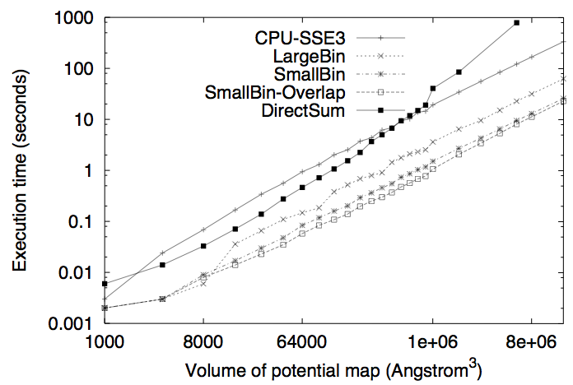
A Real Example of Data Scalability Particle-Mesh Algorithms

Slide 32
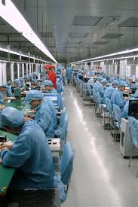
Massive Parallelism - Regularity

Slide 33
Load Balance
The total amount of time to complete a parallel job is limited by the thread that takes the longest to finish
good
bad!

Slide 34
Global Memory Bandwidth
Ideal
Reality

Slide 35
Conflicting Data Accesses Cause Serialization and Delays
Massively parallel execution cannot afford serialization
Contentions in accessing critical data causes serialization

Slide 36
What is the stake?
Scalable and portable software lasts through many hardware generations
Scalable algorithms and libraries can be the best legacy we can leave behind from this era

Slide 37
Questions?

